Slide 1
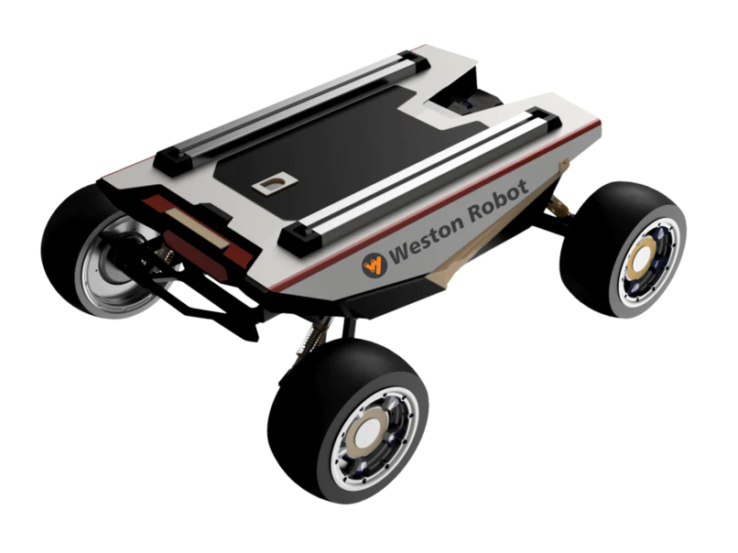
DIPARTIMENTO DI INGEGNERIA ELETTRICA E TECNOLOGIE DELL’INFORMAZIONE
SCUOLA POLITECNICA E DELLE SCIENZE DI BASE
MASTER'S DEGREE IN AUTOMATION ENGINEERING AND ROBOTICS
Field and Service Robotics project
Motion planning and control of car-like robot
Maisto Paolo, Vittozzi Angelo
Weston Robot - Robot SCOUT MINI

Slide 2
Index
Introduction
Car-like robot: kinematic modeling
Motion planning
PRM, BFS and path smoothing
Reeds-Shepp Curves and Dijkstra's algorithm
Input-Output Linearization control
Simulations and results
2/28

Slide 3
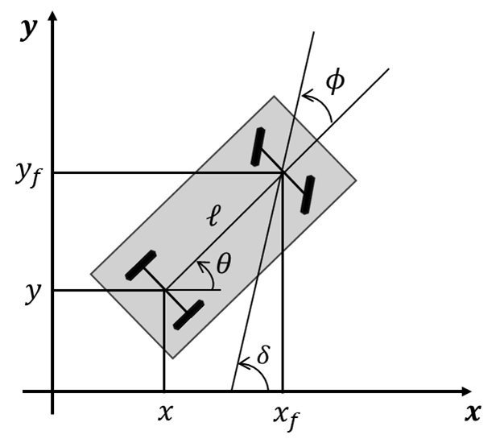

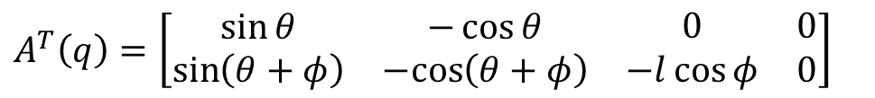
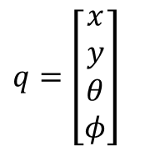



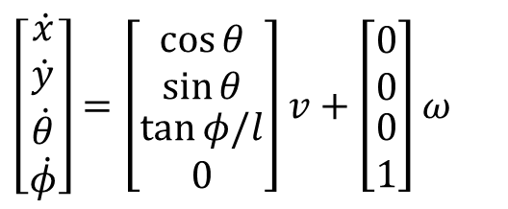
Car-like robot: kinematic modeling
Two nonholonomic constraints, one for each wheel (pure rolling constraints)
Kinematic model (rear-wheel driving)
$$\left[\begin{matrix}\begin{matrix}\dot{x} \\ \dot{y}\end{matrix} \\ \begin{matrix}\dot{θ} \\ \dot{φ}\end{matrix}\end{matrix}\right]=\left[\begin{matrix}\begin{matrix}\cos{θ} \\ \sin{θ}\end{matrix} \\ \begin{matrix}\tan{φ/l} \\ 0\end{matrix}\end{matrix}\right]v+\left[\begin{matrix}\begin{matrix}0 \\ 0\end{matrix} \\ \begin{matrix}0 \\ 1\end{matrix}\end{matrix}\right]ω$$
$$\dot{x}\sin{θ−\dot{y}\cos{θ}{=0}}$$
$${\dot{x}}_{f}\sin\left(θ+φ\right)−{\dot{y}}_{f}\cos\left(θ+φ\right)=0$$
Using rigid-body constraints
$$x_{f}=x+l\cos{θ}$$
$$y_{f}=y+l\sin{θ}$$
the second kinematic constraint becomes
$$q=\left[\begin{matrix}\begin{matrix}x \\ y\end{matrix} \\ \begin{matrix}θ \\ φ\end{matrix}\end{matrix}\right]$$
$$\dot{x}\sin\left(θ+φ\right)−\dot{y}\cos\left(θ+φ\right)−\dot{θ}l\cos{φ}=0$$
Pfaffian constraint matrix
$$A^{T}\left(q\right)=\left[\begin{matrix}\begin{matrix}\sin{θ} & −\cos{θ} \\ \sin\left(θ+φ\right) & −cos\left(θ+φ\right)\end{matrix} & \begin{matrix}0 & 0 \\ −l\cos{φ} & 0\end{matrix}\end{matrix}\right]$$
3/28

Slide 4
Goals
MOTION PLANNING
A smooth path planning algorithm is implemented for car-like robot and determine trajectory. Two algorithms are implemented:
PRM, BFS and path smoothing method
Reeds-Shepp Curves with Dijkstra’s algorithm
INPUT-OUTPUT LINEARIZATION CONTROL
Given the trajectory in the previous point, an Input/Output Linearization control approach is implemented to control the position of car-like robot.
4/28

Slide 5
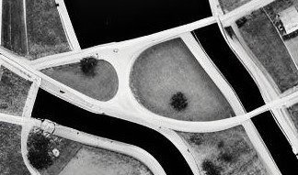
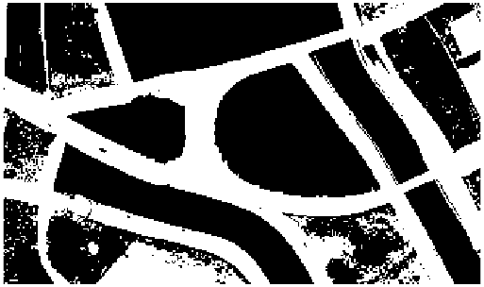

Occupancy map creation
Creation occupancy map from image with MATLAB
0 → cell with an obstacle
1 → free cell
$$y_{ref}=size\left(map,1\right)−y$$
5/28

Slide 6
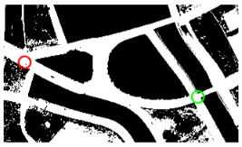
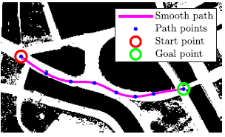
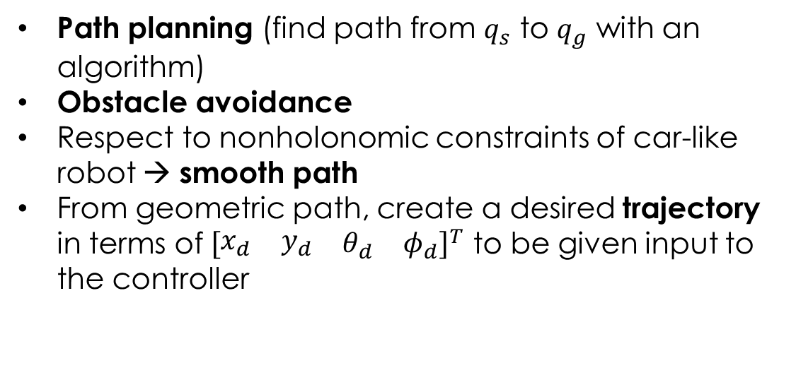
Motion planning: goals
Start point
Goal point
Path planning (find path from $q_{s}$ to $q_{g}$ with an algorithm)
Obstacle avoidance
Respect to nonholonomic constraints of car-like robot → smooth path
From geometric path, create a desired trajectory in terms of ${\left[\begin{matrix}\begin{matrix}x_{d} & y_{d}\end{matrix} & \begin{matrix}θ_{d} & φ_{d}\end{matrix}\end{matrix}\right]}^{T}$ to be given input to the controller
Trajectory
6/28

Slide 7
Motion planning: 2 approaches
1
2
Probabilistic Roadmaps (PRM)
Reeds-Shepp Curves
Smooth path
Breadth-first search (BFS)
Dijkstra's algorithm
Objective:
Path smoothing
7/28

Slide 8
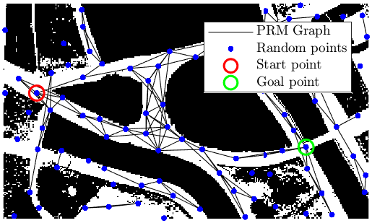
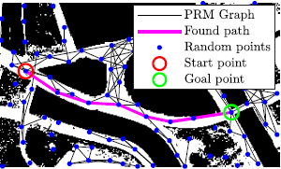
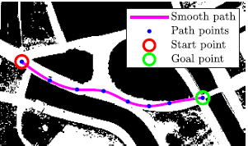
Motion planning: 1° approach
1
Probabilistic Roadmaps (PRM)
Breadth-first search (BFS)
Probabilistic Roadmap Method (PRM)
Breadth-First Search (BFS)
Path smoothing
Path smoothing
8/28

Slide 9
Motion planning: Probabilistic Roadmap Method (PRM)
Roadmap construction
Sampling
Collision Checking
Connecting Nodes
1
Adding Start and Goal
2
Graph creation
3
Termination criteria
4
Next step → find a path with a graph search algorithm
9/28

Slide 10
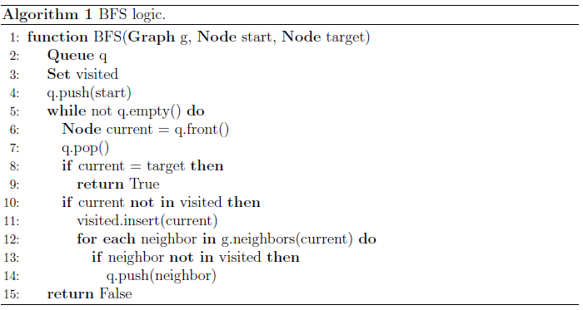
Motion planning: Breadth-First Search (BFS)
From PRM → graph that connects the various nodes including the initial and final point
Now the goal is to find the path that allows to go from the start point to the goal point → Breadth-First Search (BFS)
Next step → make the path smooth
10/28

Slide 11
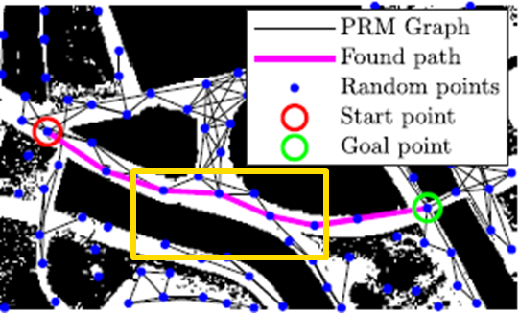

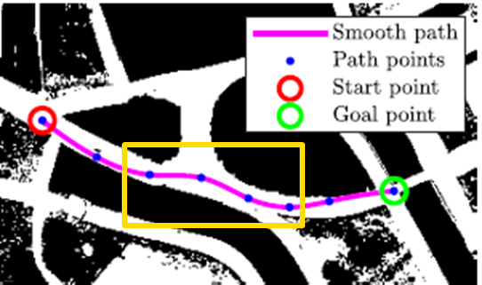

Motion planning: path smoothing
Obtained path, which allows to go from the initial point to the final point, is constituted by broken lines
The aim is to make the path smooth in order to eliminate the cusps within the path (as the car-like robot is not able to rotate on itself) → Spline
Path found with PRM + BFS
Path with spline interpolation
11/28

Slide 12
Motion planning: path smoothing
Path found with PRM BFS
Path with spline interpolation
12/28

Slide 13
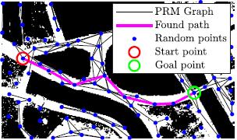
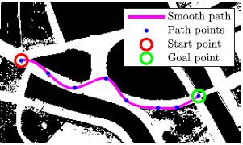
Motion planning: obstacle collision check
A candidate found path
Smooth path intersecting obstacles
Another candidate found path
Obstacle-free smooth path
13/28

Slide 14
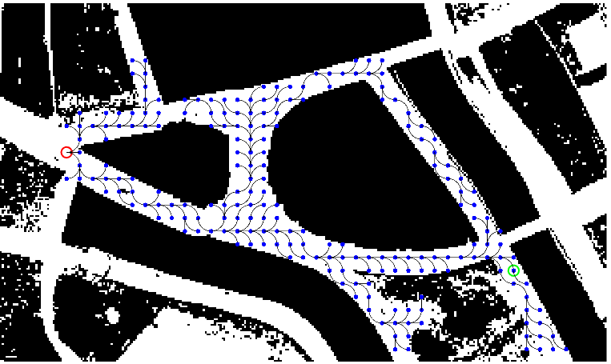
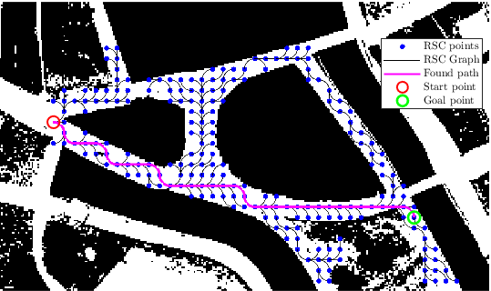
Motion planning: 2° approach
2
Reeds-Shepp Curves
Dijkstra's algorithm
14/28

Slide 15
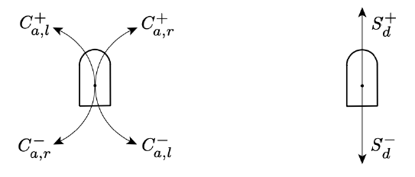

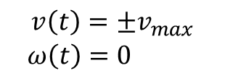

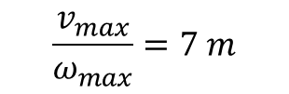
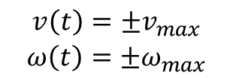
Motion planning: Reeds-Shepp Curves
Dubins Curves
No cusps because the movement is always forward.
Circular arcs of varying lengths traversed with velocities:
$$\begin{matrix}{v\left(t\right)=±v}_{max} \\ {ω\left(t\right)=±ω}_{max}\end{matrix}$$
The radius of these circular arcs is determined by
$$\frac{v_{max}}{ω_{max}}=7 m$$
Linear segments of varying lengths traversed with velocities:
$$\begin{matrix}{v\left(t\right)=±v}_{max} \\ {ω\left(t\right)=0}_{ }\end{matrix}$$
The curves are designed to satisfy the kinematic constraints of the robot, considering only certain motion primitives ($C_{a,l}^{+}$ and $C_{a,r}^{+}$ for circular arcs and $S_{d}^{+}$ for linear segments).
Velocity limits:
Next step → find the optimal path with an optimization algorithm
$$\begin{matrix} v_{max}=3 m/s \\ { ω}_{max}=0.43 rad/s\end{matrix}$$
15/28

Slide 16

Motion planning: Dijkstra's algorithm
Find neighbors
1
Update distance costs
2
Select next node & repeat
3
Termination criteria
4
16/28

Slide 17

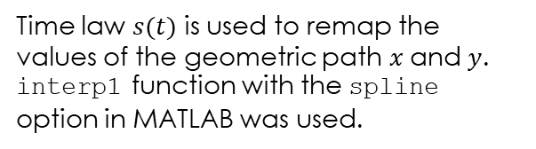


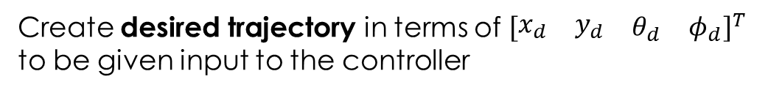
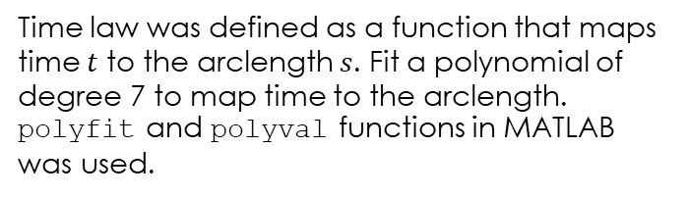
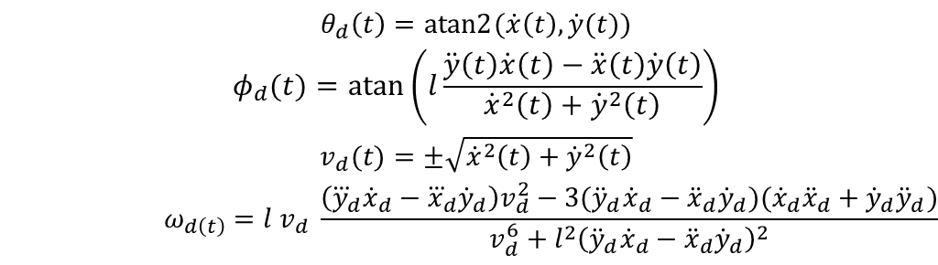
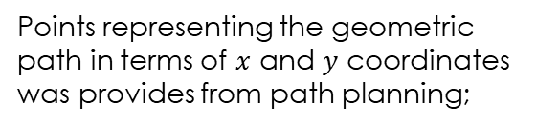
Motion planning: trajectory
TRAJECTORY = PATH + TIME LAW
1
From geometric path $q(s)$
Points representing the geometric path in terms of $x$ and $y$ coordinates was provides from path planning;
Adding time law $s\left(t\right)$
2
Time law was defined as a function that maps time $t$ to the arclength $s$. Fit a polynomial of degree 7 to map time to the arclength. polyfit and polyval functions in MATLAB was used.
3
Trajectory: $x(t)$ and $y(t)$
Time law $s(t)$ is used to remap the values of the geometric path $x$and $y$. interp1 function with the spline option in MATLAB was used.
4
Create desired trajectory in terms of ${\left[\begin{matrix}\begin{matrix}x_{d} & y_{d}\end{matrix} & \begin{matrix}θ_{d} & φ_{d}\end{matrix}\end{matrix}\right]}^{T}$ to be given input to the controller
$$\begin{matrix}\begin{matrix}θ_{d}\left(t\right)=atan2{(\dot{x}\left(t\right),\dot{y}(t)}) \\ φ_{d}(t)=atan\left(l\frac{\ddot{y}\left(t\right)\dot{x}\left(t\right)−\ddot{x}\left(t\right)\dot{y}\left(t\right)}{{\dot{x}}^{2}\left(t\right)+{\dot{y}}^{2}\left(t\right)}\right)\end{matrix} \\ \begin{matrix}v_{d}(t)=±\sqrt{{\dot{x}}^{2}\left(t\right)+{\dot{y}}^{2}\left(t\right)} \\ ω_{d\left(t\right)}=l v_{d} \frac{\left({\overset{⃛}{y}}_{d}{\dot{x}}_{d}−{\overset{⃛}{x}}_{d}{\dot{y}}_{d}\right)v_{d}^{2}−3({\ddot{y}}_{d}{\dot{x}}_{d}−{\ddot{x}}_{d}{\dot{y}}_{d})({\dot{x}}_{d}{\ddot{x}}_{d}+{\dot{y}}_{d}{\ddot{y}}_{d})}{v_{d}^{6}+l^{2}{\left({\ddot{y}}_{d}{\dot{x}}_{d}−{\ddot{x}}_{d}{\dot{y}}_{d}\right)}^{2}}\end{matrix}\end{matrix}$$
17/28

Slide 18
Goals
MOTION PLANNING
A smooth path planning algorithm is implemented for car-like robot and determine trajectory. Two algorithms are implemented:
PRM, BFS and path smoothing method
Reeds-Shepp Curves with Dijkstra’s algorithm
INPUT-OUTPUT LINEARIZATION CONTROL
Given the trajectory in the previous point, an Input/Output Linearization control approach is implemented to control the position of car-like robot.
18/28

Slide 19
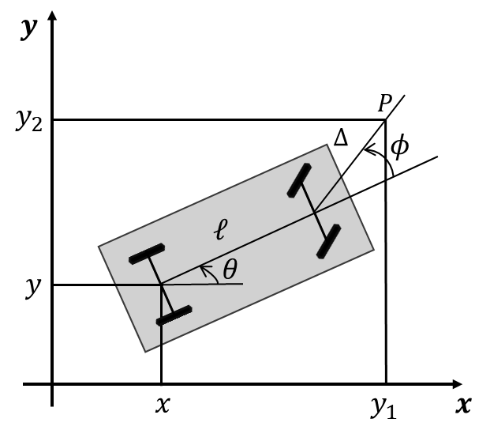


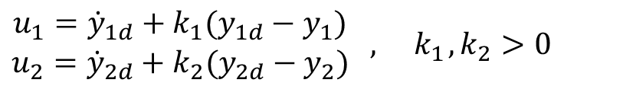

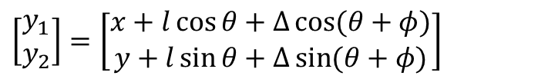
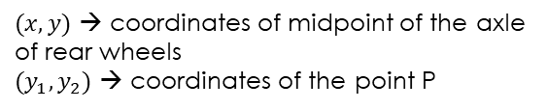
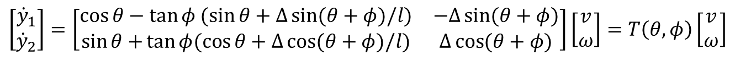

Input-Output Linearization control
The output choice for the trajectory tracking task is:
$$y=\left[\begin{matrix}x \\ y\end{matrix}\right]$$
System output is redefined as:
$$\left[\begin{matrix}y_{1} \\ y_{2}\end{matrix}\right]=\left[\begin{matrix}x+l\cos{θ+Δ\cos{(θ+φ)}} \\ y+l\sin{θ+Δ\sin{(θ+φ)}}\end{matrix}\right]$$
The time derivatives of these outputs (substituting the kinematic model of the car-like robot) :
$$\left[\begin{matrix}{\dot{y}}_{1} \\ {\dot{y}}_{2}\end{matrix}\right]=\left[\begin{matrix}\cos{θ}−\tan{φ (\sin{θ+Δ\sin{(θ+φ)/l)}}} & −Δ\sin{(θ+φ)} \\ \sin{θ+}\tan{φ(\cos{θ+Δ\cos{(θ+φ)/l)}}} & Δ\cos{(θ+φ)}\end{matrix}\right]\left[\begin{matrix}v \\ ω\end{matrix}\right]=T\left(θ,φ\right)\left[\begin{matrix}v \\ ω\end{matrix}\right]$$
$$\left[\begin{matrix}{\dot{y}}_{1} \\ {\dot{y}}_{2}\end{matrix}\right]=\left[\begin{matrix}u_{1} \\ u_{2}\end{matrix}\right]$$
$$\left(\begin{matrix}\text{where} \left[\begin{matrix}u_{1} \\ u_{2}\end{matrix}\right] \text{are} \text{two} \\ \text{virtual} \text{control} \text{inputs}\end{matrix}\right)$$
Since $\det{T\left(θ,φ\right)=Δ/\cos{φ≠0}}$, we can set:
$(x,y)$ → coordinates of midpoint of the axle of rear wheels
$(y_{1},y_{2})$ → coordinates of the point P
Heading velocity and angular velocity:
$$\left[\begin{matrix}v \\ ω\end{matrix}\right]=T^{−1}\left(θ,φ\right)\left[\begin{matrix}u_{1} \\ u_{2}\end{matrix}\right]$$
Controller
$$\begin{matrix}u_{1}={\dot{y}}_{1d}+k_{1}(y_{1d}−y_{1}) \\ u_{2}={\dot{y}}_{2d}+k_{2}(y_{2d}−y_{2})\end{matrix} , { k}_{1}, k_{2}>0$$
19/28

Slide 20
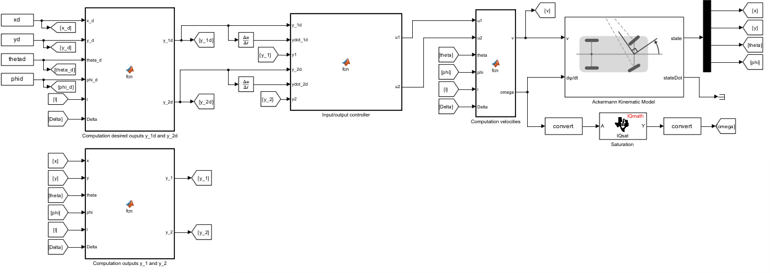
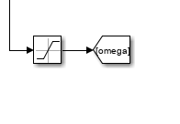
Input-Output Linearization control
Current states
Velocities
Desired outputs
Virtual control inputs
Desired trajectory
Current states
Outputs
20/28

Slide 21
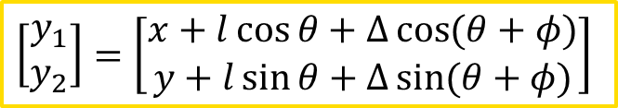
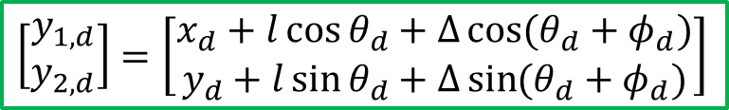
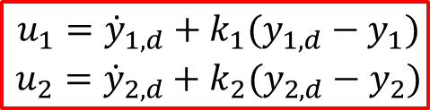
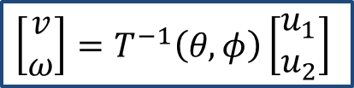


Input-Output Linearization control
$\begin{matrix}k_{1}=5 \\ k_{2}=5\end{matrix}$ PRM + BFS
$\begin{matrix}k_{1}=50 \\ k_{2}=50\end{matrix}$ RSC + Dijkstra
$$\left[\begin{matrix}\begin{matrix}\dot{x} \\ \dot{y}\end{matrix} \\ \begin{matrix}\dot{θ} \\ \dot{φ}\end{matrix}\end{matrix}\right]=\left[\begin{matrix}\begin{matrix}\cos{θ} \\ \sin{θ}\end{matrix} \\ \begin{matrix}\tan{φ/l} \\ 0\end{matrix}\end{matrix}\right]v+\left[\begin{matrix}\begin{matrix}0 \\ 0\end{matrix} \\ \begin{matrix}0 \\ 1\end{matrix}\end{matrix}\right]ω$$
$$\begin{matrix}u_{1}={\dot{y}}_{1,d}+k_{1}(y_{1,d}−y_{1}) \\ u_{2}={\dot{y}}_{2,d}+k_{2}(y_{2,d}−y_{2})\end{matrix}$$
$$\left[\begin{matrix}v \\ ω\end{matrix}\right]=T^{−1}\left(θ,φ\right)\left[\begin{matrix}u_{1} \\ u_{2}\end{matrix}\right]$$
$$\left[\begin{matrix}y_{1,d} \\ y_{2,d}\end{matrix}\right]=\left[\begin{matrix}x_{d}+l\cos{θ_{d}+Δ\cos{(θ_{d}+φ_{d})}} \\ y_{d}+l\sin{θ_{d}+Δ\sin{(θ_{d}+φ_{d})}}\end{matrix}\right]$$
$$\left[\begin{matrix}y_{1} \\ y_{2}\end{matrix}\right]=\left[\begin{matrix}x+l\cos{θ+Δ\cos{(θ+φ)}} \\ y+l\sin{θ+Δ\sin{(θ+φ)}}\end{matrix}\right]$$
21/28

Slide 22
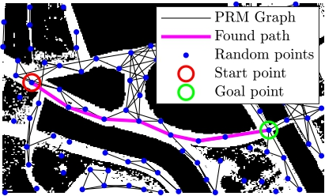
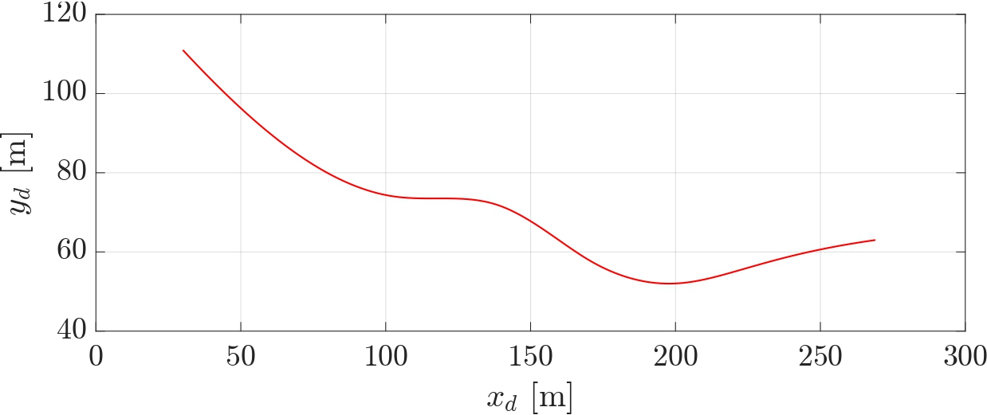
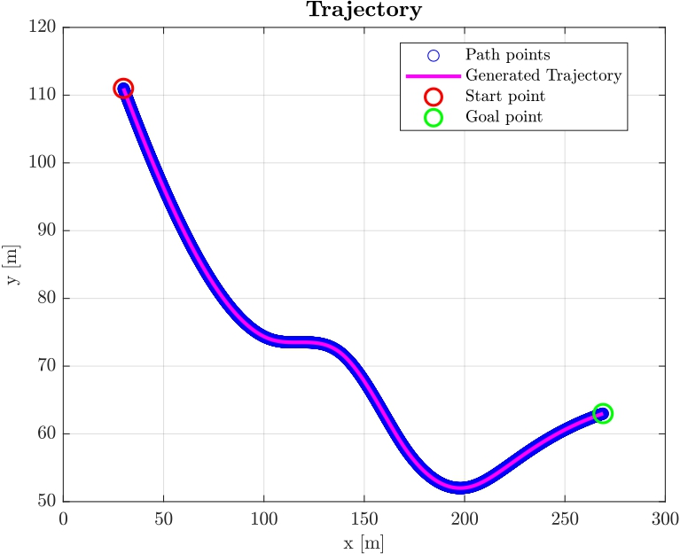
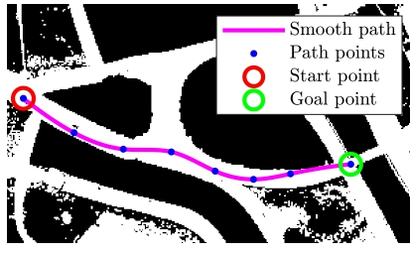
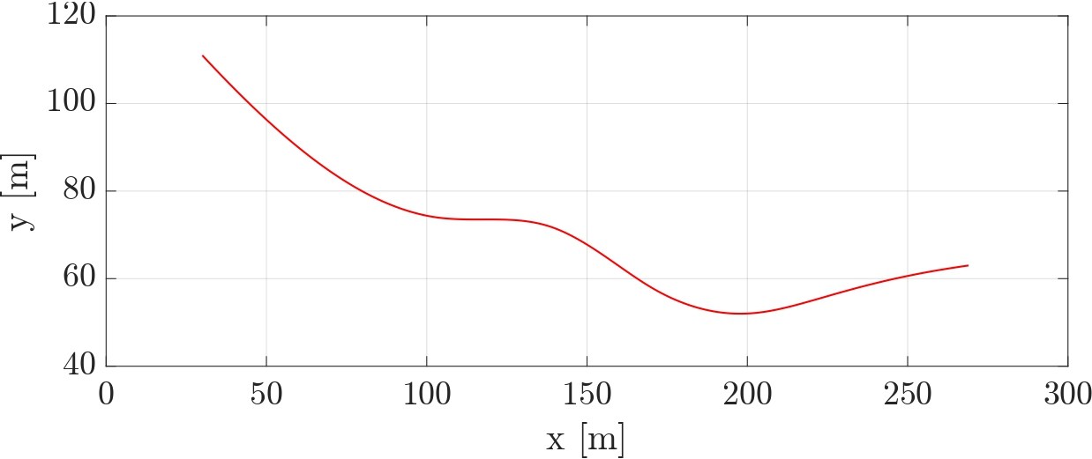
Simulations and Results: 1° approach
Found path with PRM + BFS
Desired trajectory in SIMULINK
Desired trajectory in MATLAB
Smoothed path
Performed trajectory in SIMULINK
22/28

Slide 23
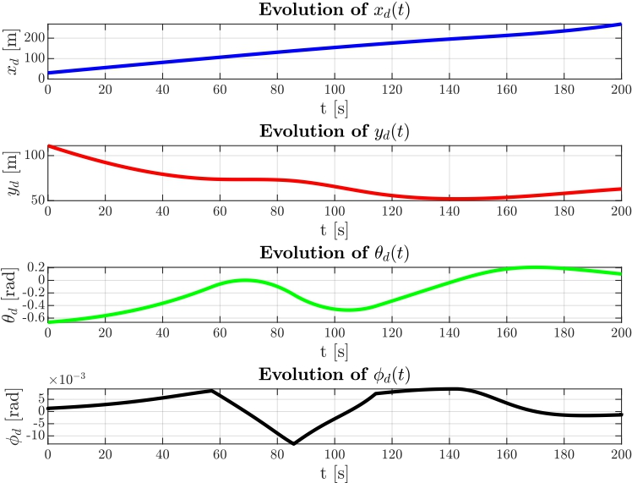
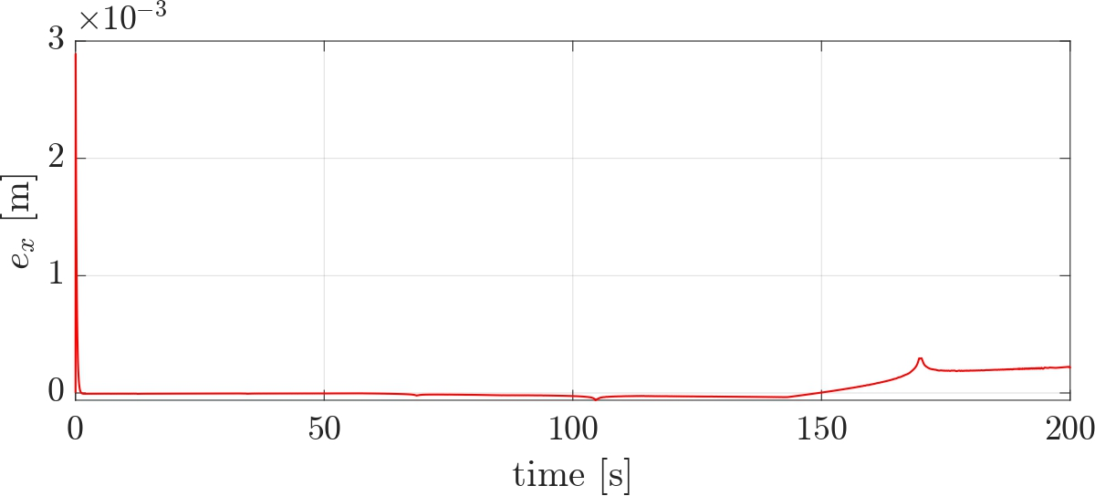







Simulations and Results: 1° approach
Error of $x$
Error of $y$
Error of $θ$
Error of $φ$
23/28

Slide 24


Simulations and Results: 1° approach
Heading velocity and angular velocity in MATLAB
Heading velocity and angular velocity in SIMULINK
24/28

Slide 25




Simulations and Results: 2° approach
Desired trajectory in SIMULINK
Optimal path
Desired trajectory in MATLAB
Performed trajectory in SIMULINK
25/28

Slide 26





Simulations and Results: 2° approach
Error of $x$
Error of $y$
Error of $θ$
Error of $φ$
26/28

Slide 27


Simulations and Results: 2° approach
Heading velocity and angular velocity in MATLAB
Heading velocity and angular velocity in SIMULINK
27/28

Slide 28
Thank you for your attention !!
28/28

